Slide 1
Policy Gradient on Single Server for optimum blocking
16-Nov-2021
Ref: simulators.py -> SimulatorQueue class

Slide 2
TODO
Plot the true value function as a comparison --> try to plot the points on top, as a boxplot... but how? I would need to bin the theta values and this is not so easy...
Compare methods (1) and (2) with comparable alpha values (without adjustment)
Analyze the case where the true theta is large (does it converge?)

Slide 3
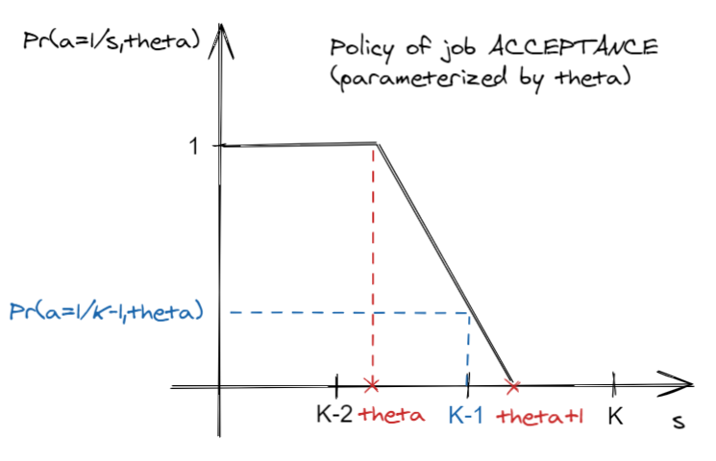
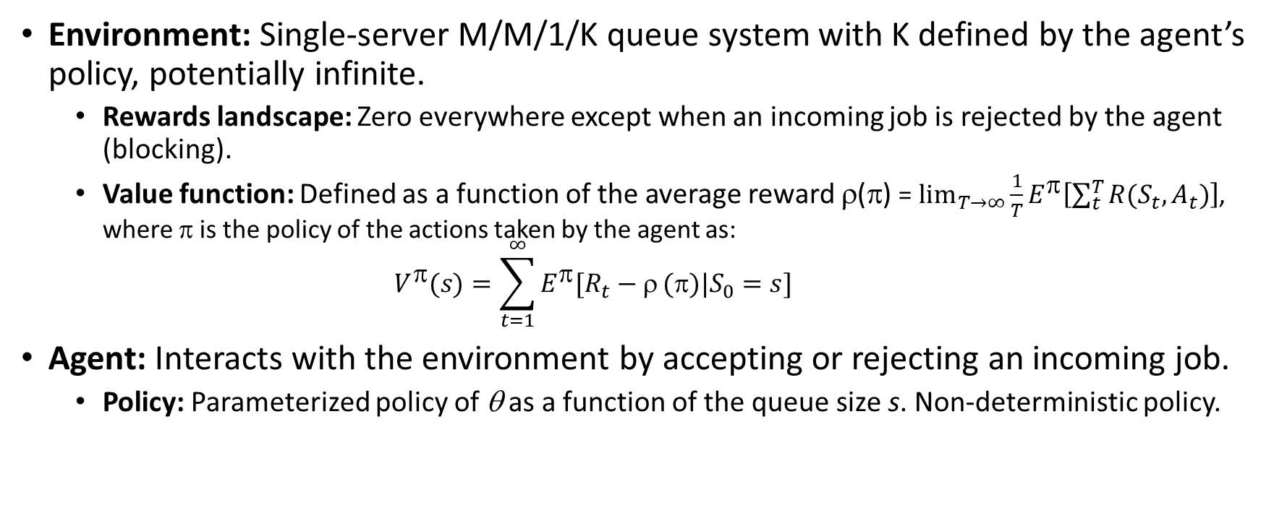
The environment and the agent of the RL problem
Environment: Single-server M/M/1/K queue system with K defined by the agent’s policy, potentially infinite.
Rewards landscape: Zero everywhere except when an incoming job is rejected by the agent (blocking).
Value function: Defined as a function of the average reward ρ(π) = $\lim_{T→∞}{\frac{1}{T}E^{π}\left[\sum_{t}^{T}{R(S_{t},A_{t})}\right]}$, where π is the policy of the actions taken by the agent as: $V^{π}(s)=\sum_{t=1}^{∞}{E^{π}[R_{t}−ρ}(π)|S_{0}=s]$
Agent: Interacts with the environment by accepting or rejecting an incoming job.
Policy: Parameterized policy of θ as a function of the queue size s. Non-deterministic policy.
Learning: Policy gradient learning of the optimum parameter that maximizes the average reward. Learning is done by estimating the required quantities either by Monte-Carlo or Fleming-Viot.

Slide 4
Policy gradient learning

Slide 5
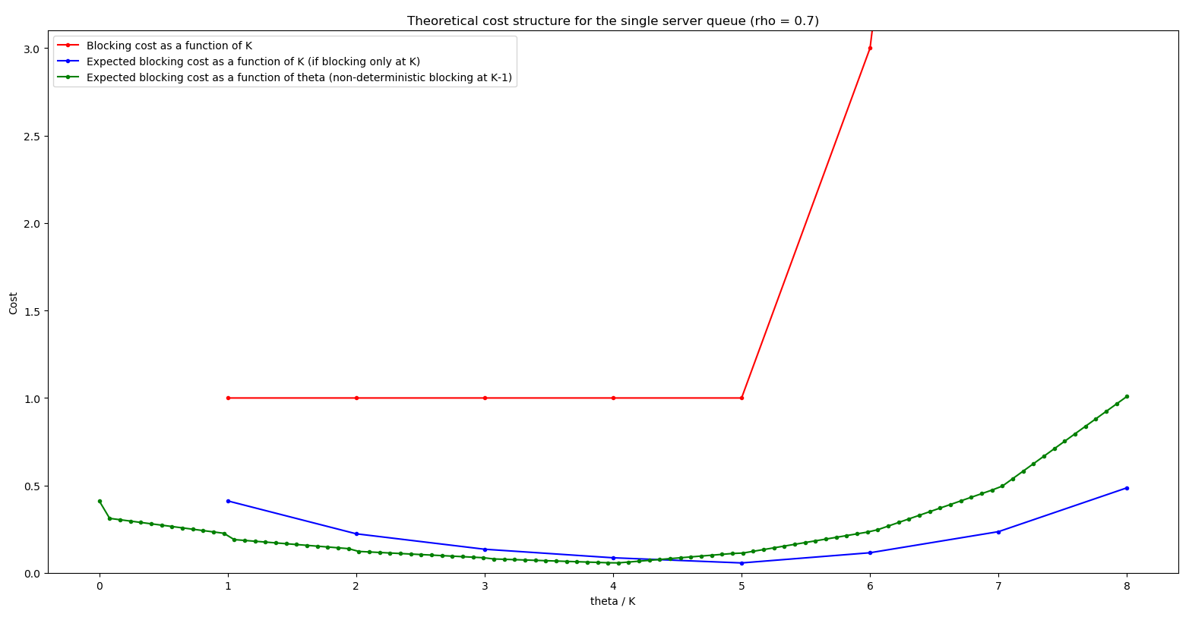
Theoretical blocking cost structure
Notes on the blocking cost function: (Wed, 17-Nov-2021)
Interpretation of current cost: the larger the K the system is more reliable, then blocking with larger K is more serious.
Cost function should probably be changed to strictly increasing function of K, for easier understanding/selling/realistic.
When blocking occurs, the system is completely out of function (e.g. Cards castle problem, but this is a different problem, because in the latter when destruction occurs, the state goes to 0).

Slide 6
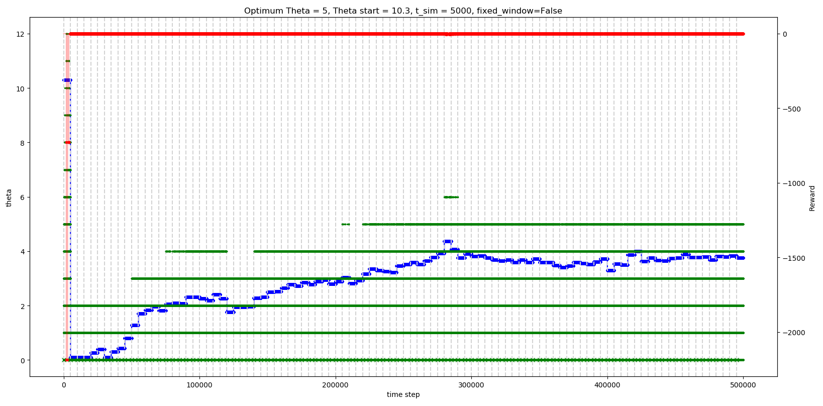
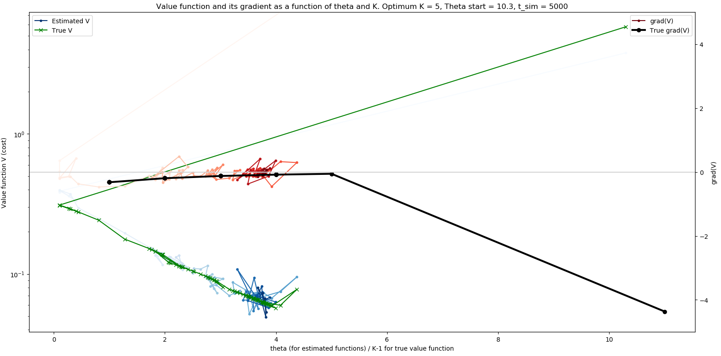
Method 1: Update once at end of episode (T = 5,000) (α = 1, no constraint on delta(θ))

Slide 7
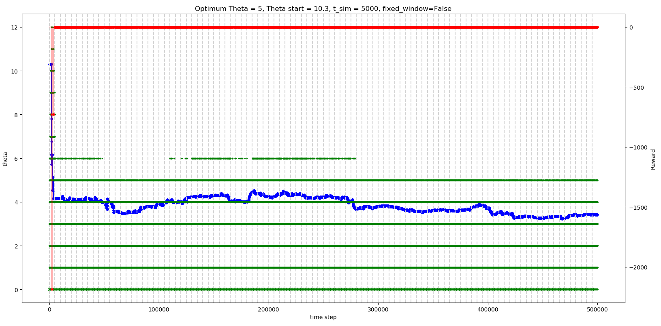
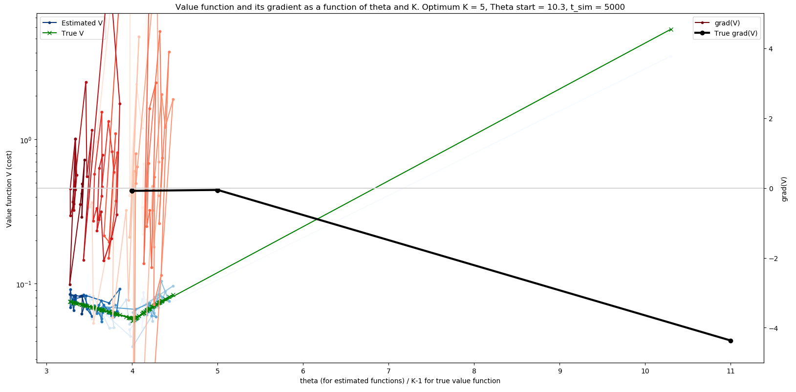
Method 2: Update at every time step (T = 5,000) (α = 1/T, no constraint on delta(θ))

Slide 8
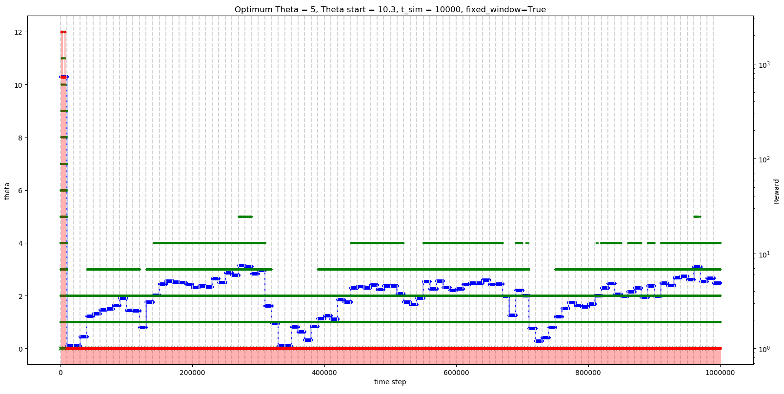
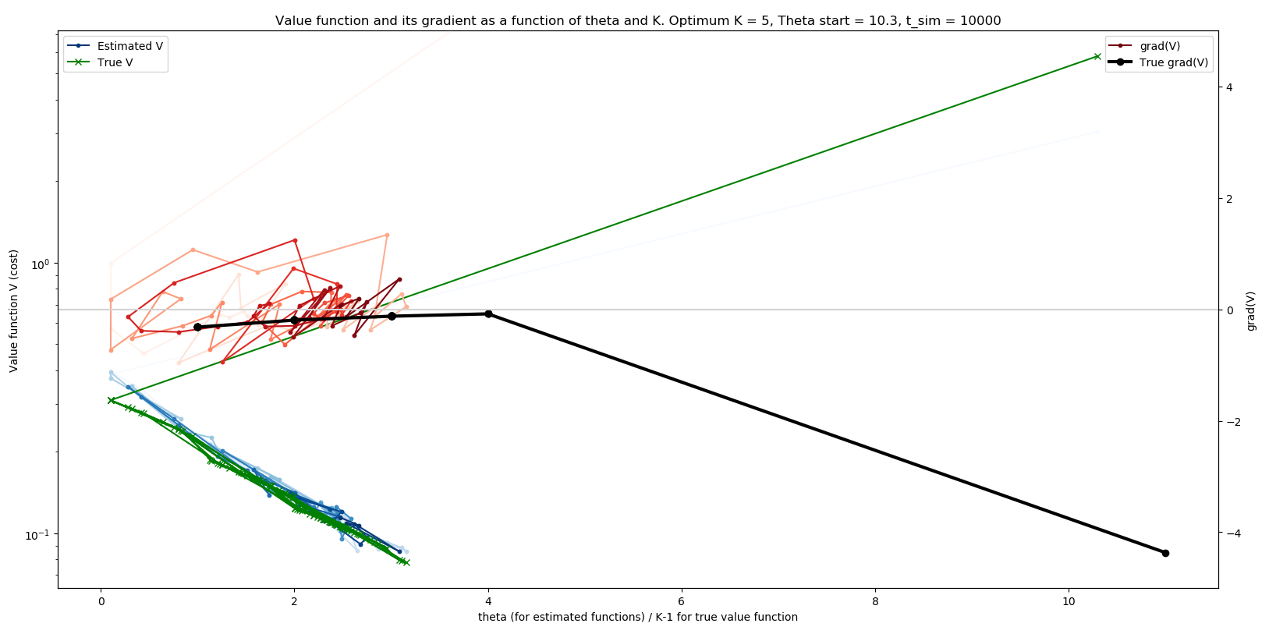
Method 3: Update once at end of episode (T = 10,000) (α = 1, no constraint on delta(θ))

Slide 9
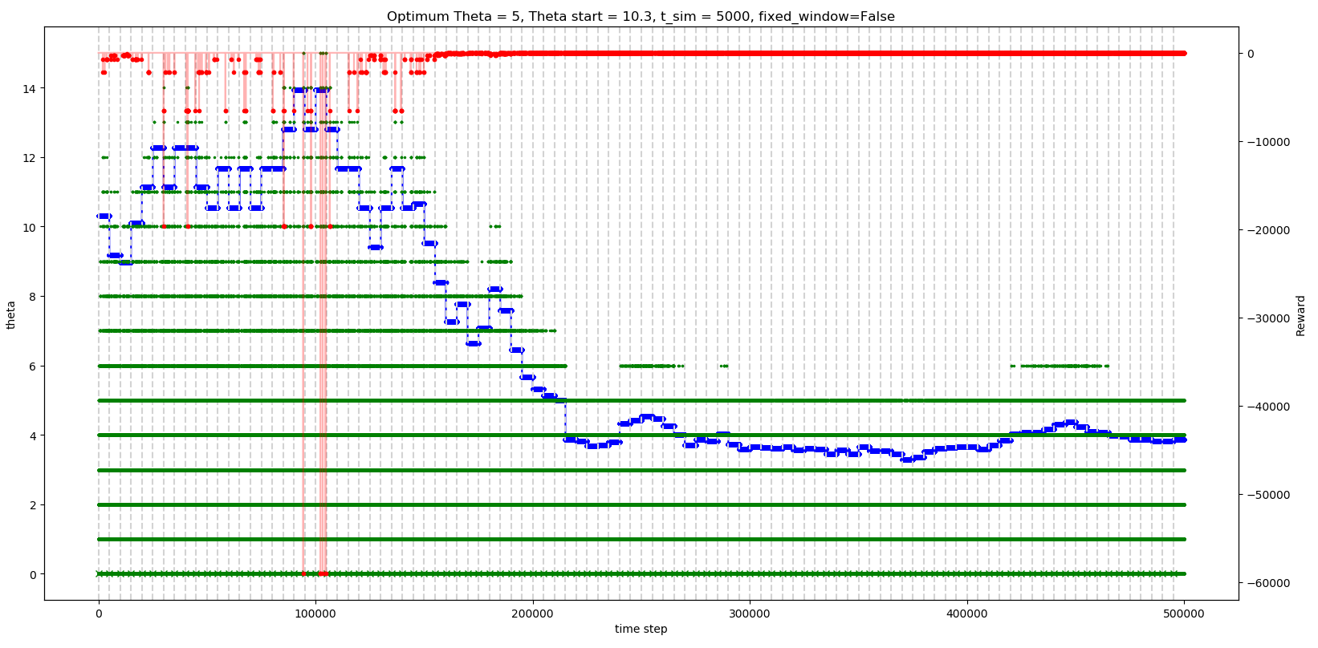
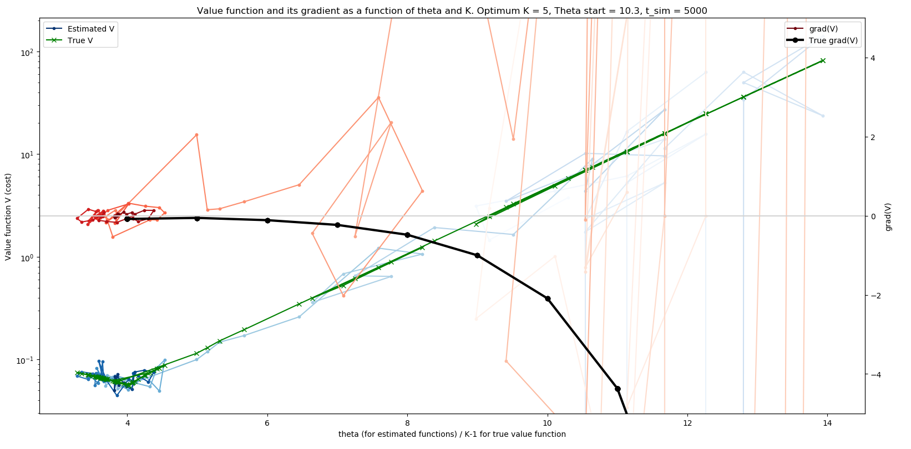
Method 1: Update once at end of episode (T = 5,000) (α = 1, |delta(θ)| <= 1.131)

Slide 10
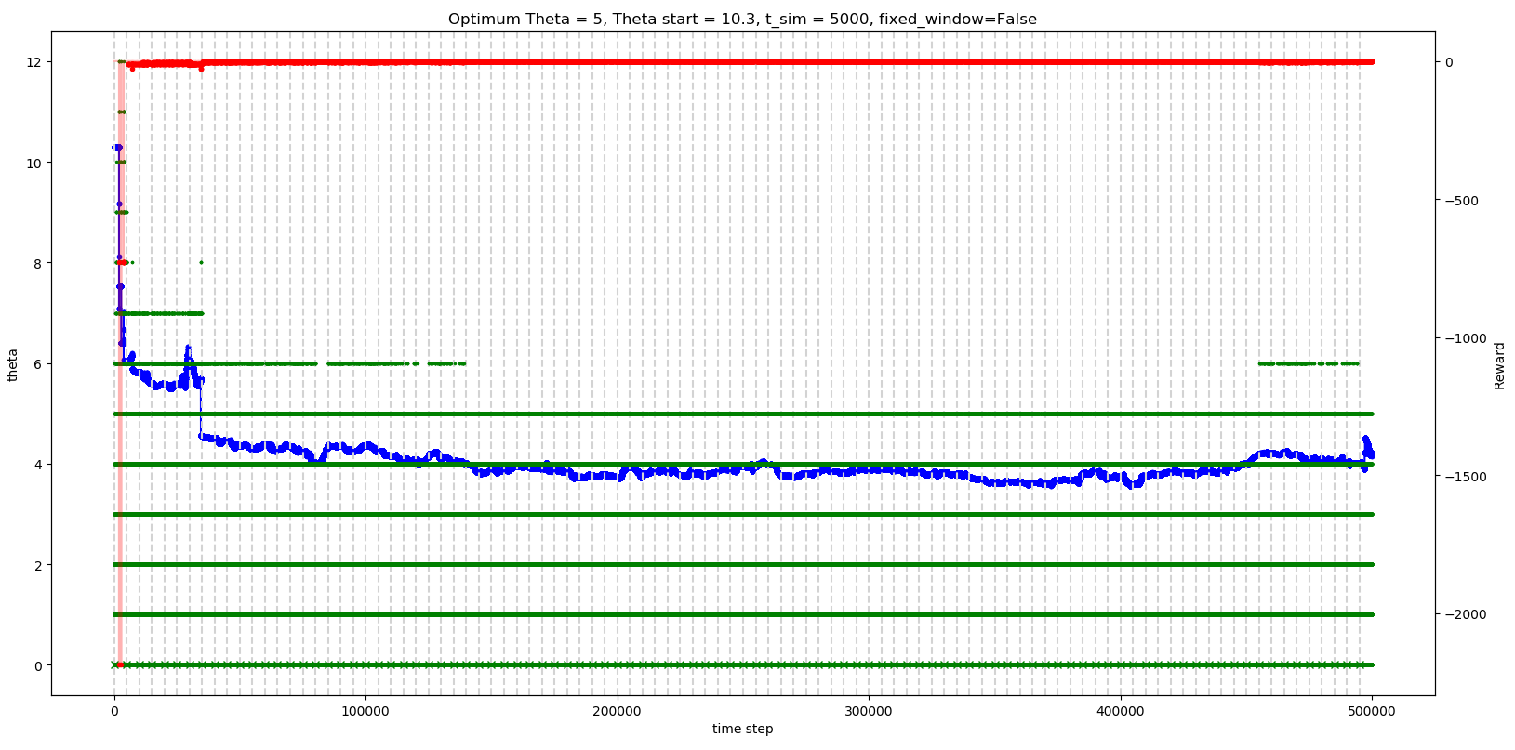
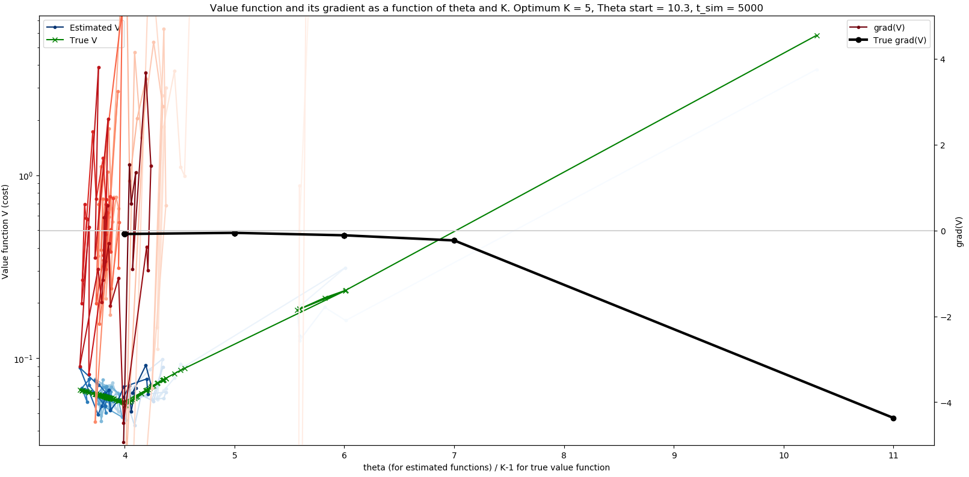
Method 2: Update at every time step (T = 5,000) (α = 1/T, |delta(θ)| <= 1.131)

Slide 11
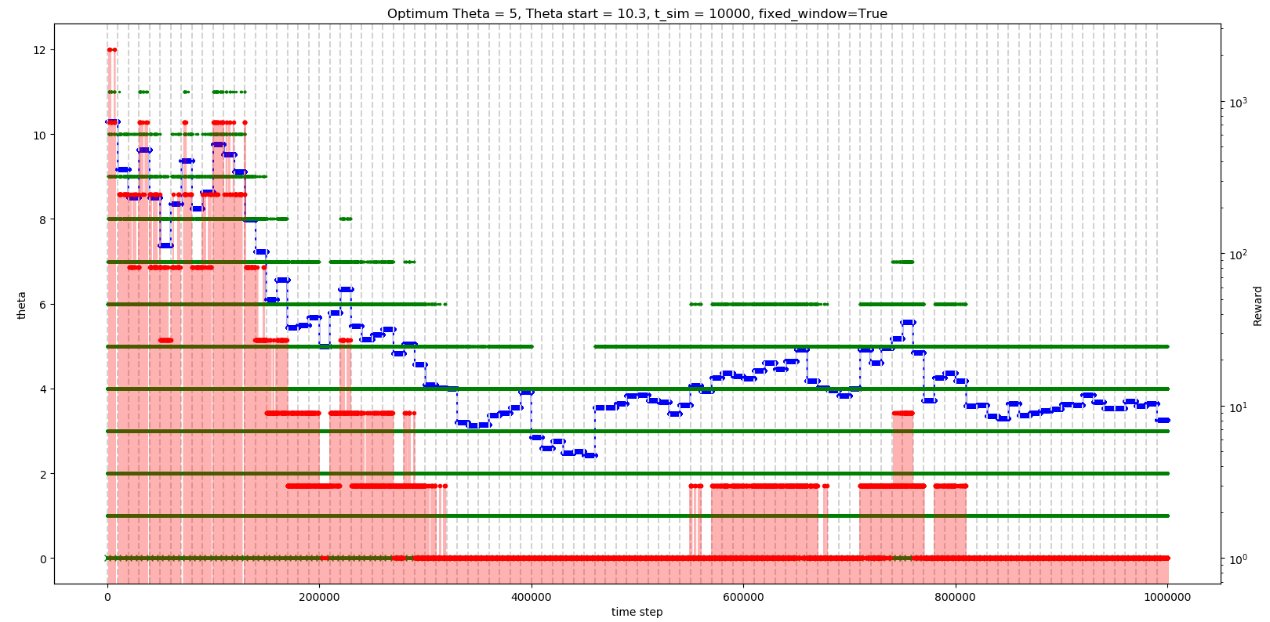
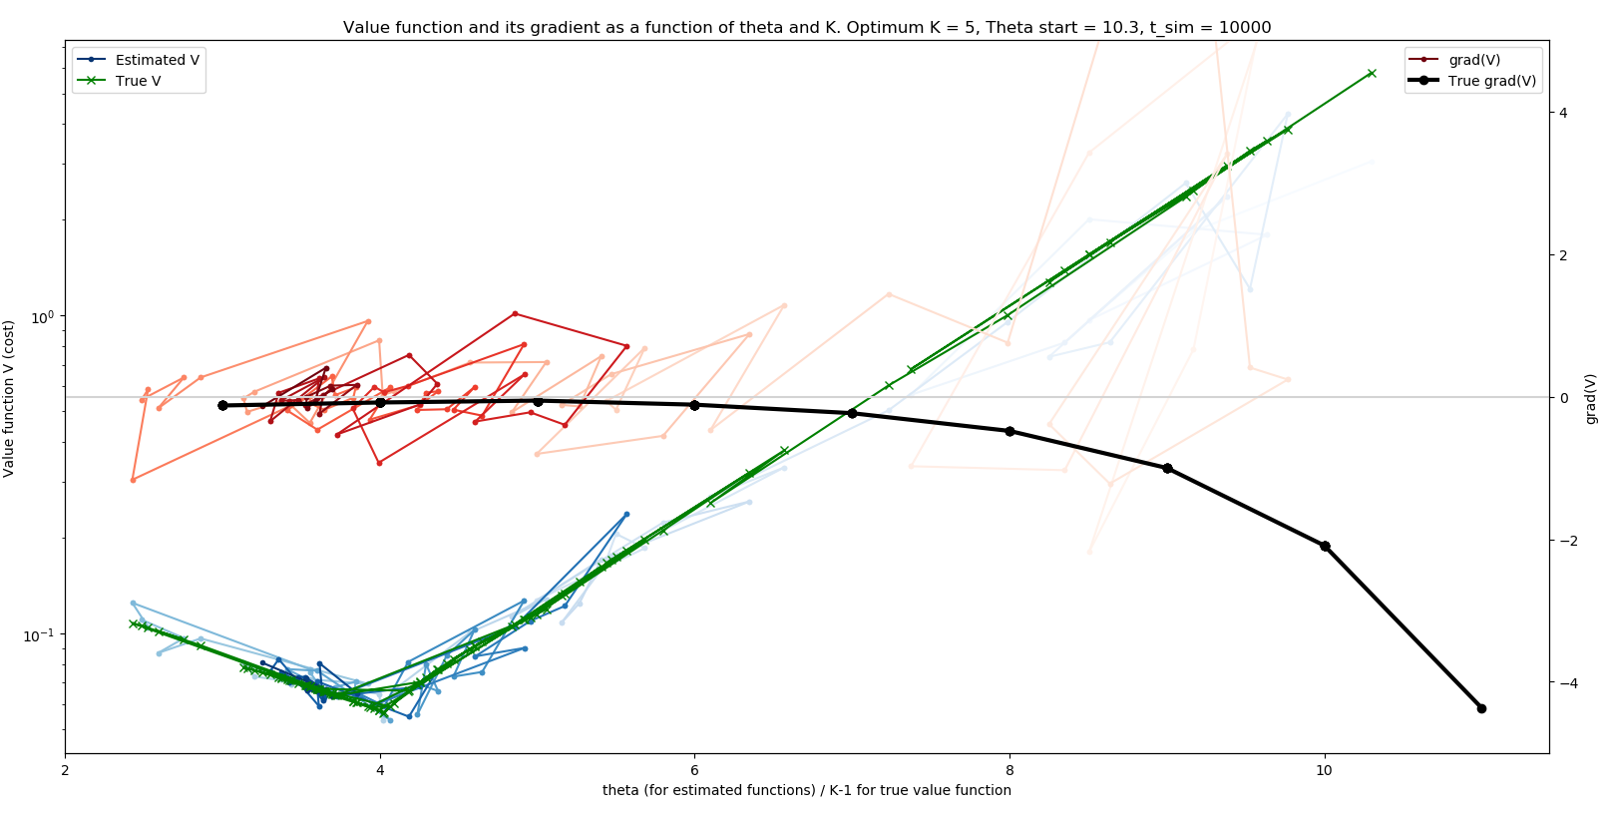
Method 3: Update once at end of episode (T = 10,000) (α = 1, |delta(θ)| <= 1.131)

Slide 12
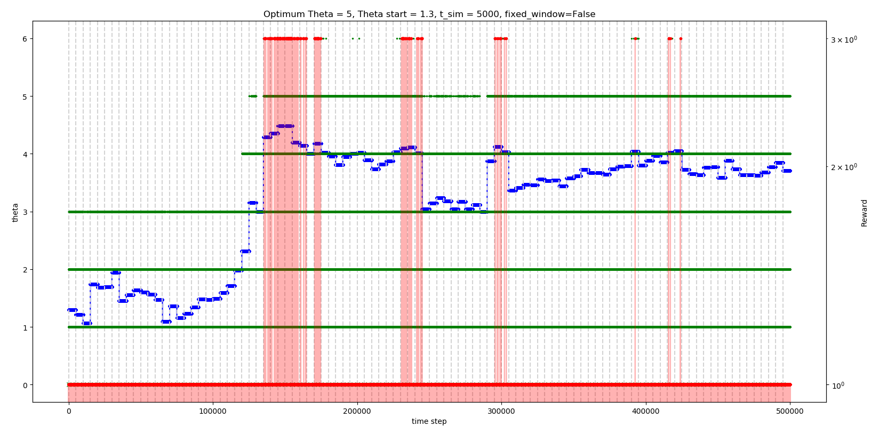
Method 1: T = 5,000, start at θ = 1.3 (small) (α = 1, no constraint on delta(θ))

Slide 13
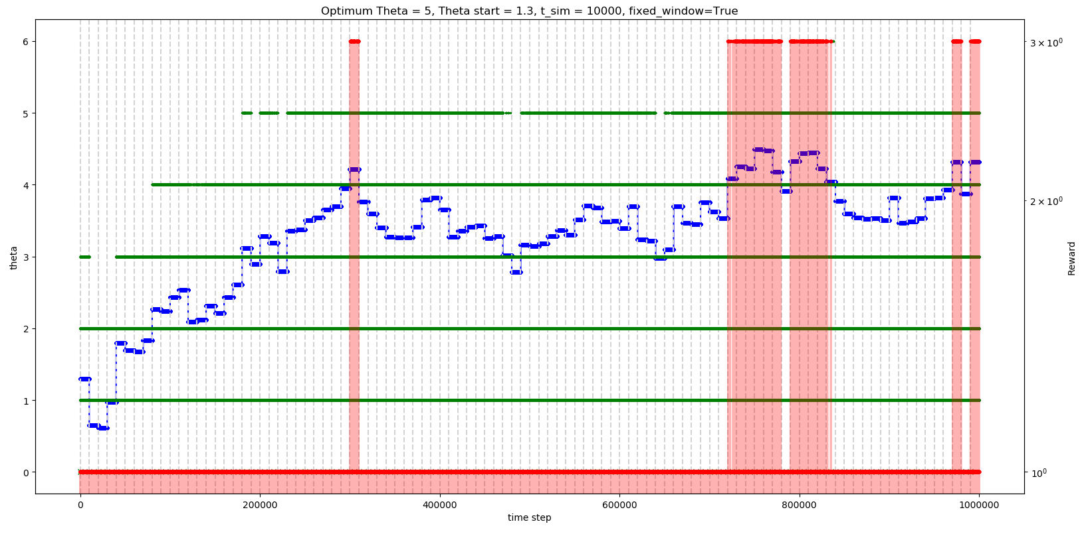
Method 3: T = 10,000, start at θ = 1.3 (small) (α = 1, no constraint on delta(θ))

Slide 14
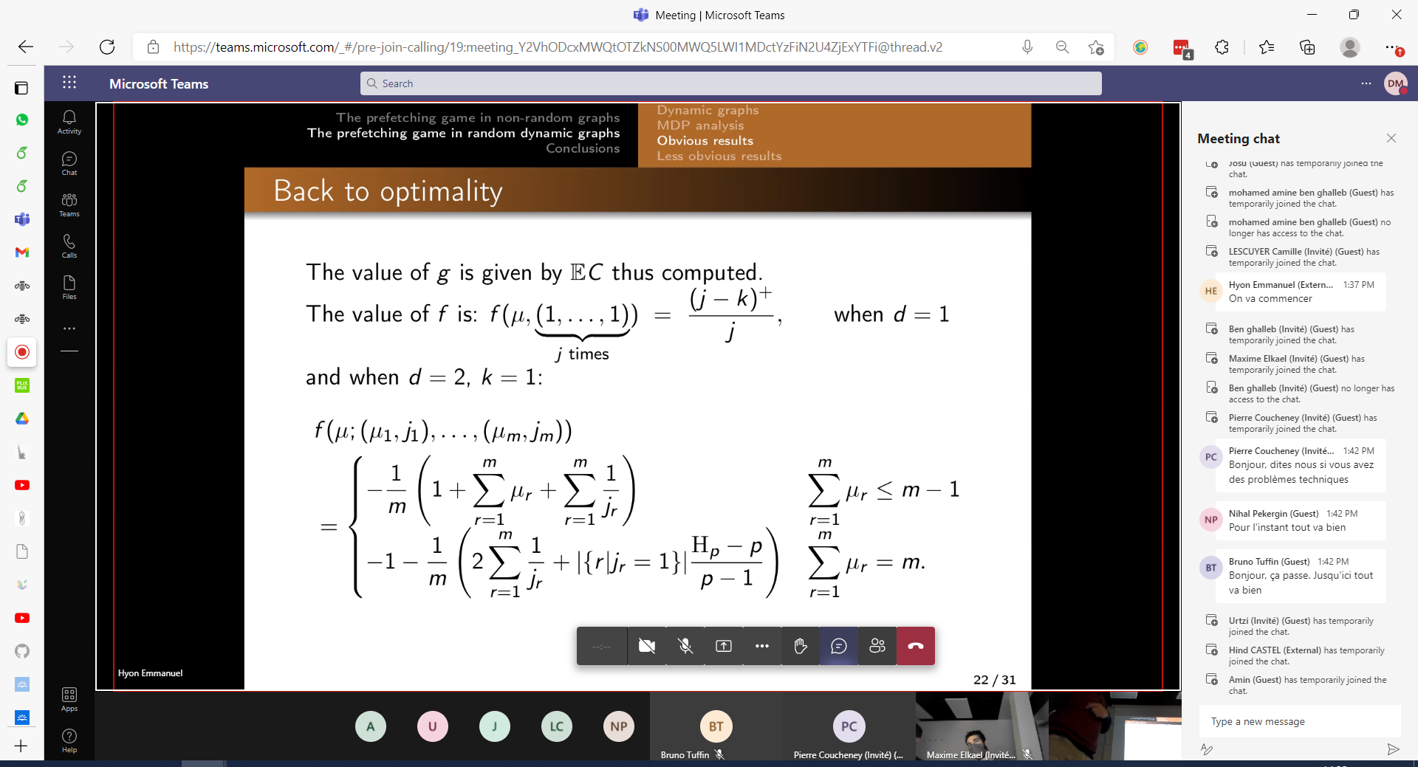
f(s) + g = … (average reward context) Ref: conference at Paris on 22-Nov-2021

Slide 15
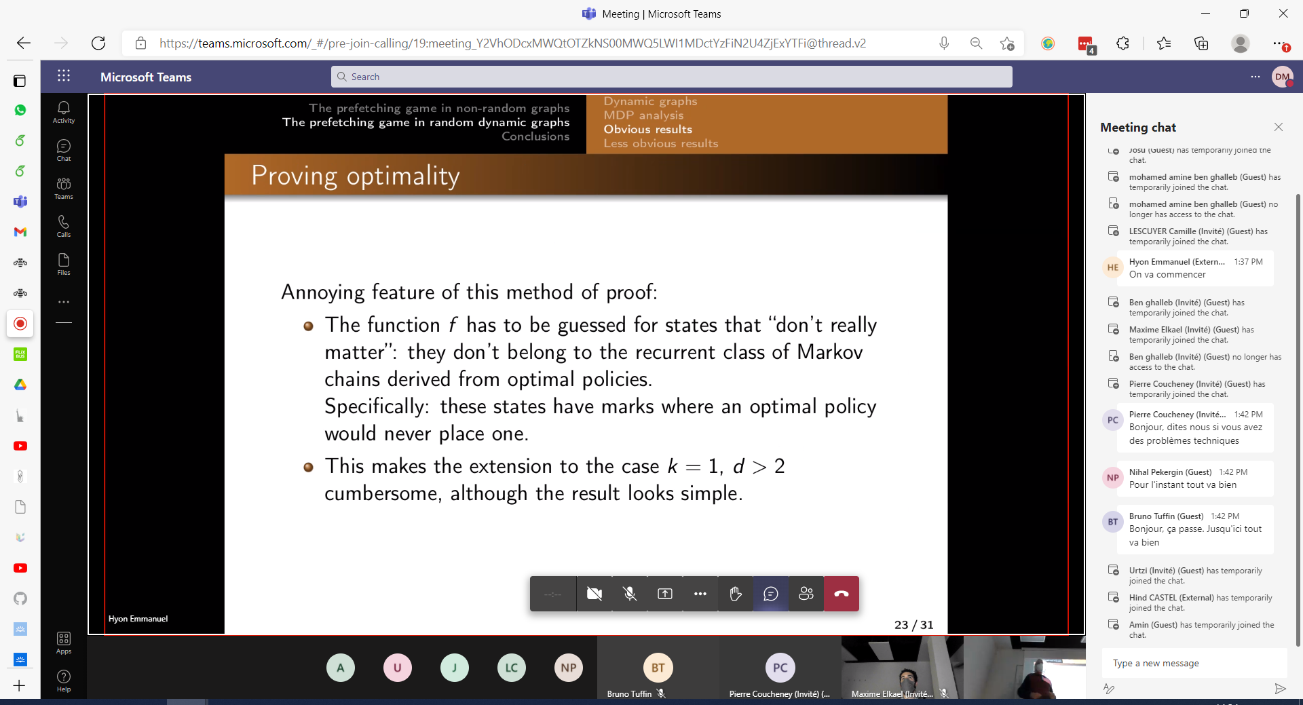
f(s) + g = … cont’d

Slide 16
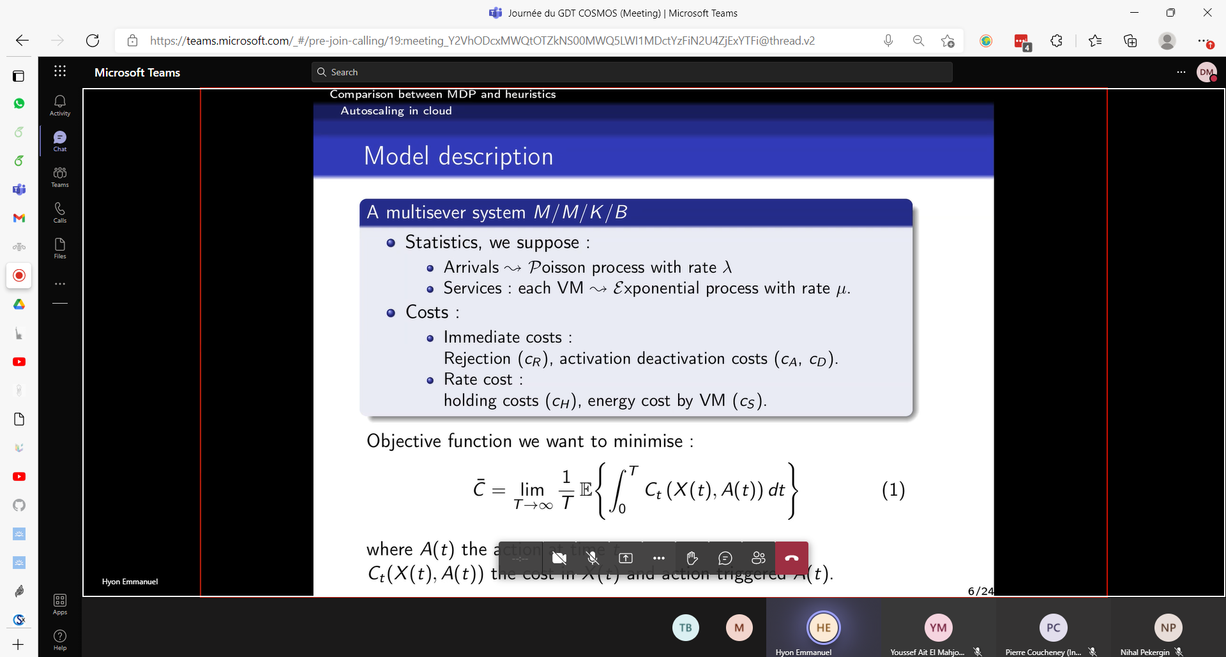

Slide 17
Thu, 25-Nov-2021 After fixing discrete-time indices
That is, each discrete-time index is defined by a new job arrival, but NOT by a job being served.

Slide 18
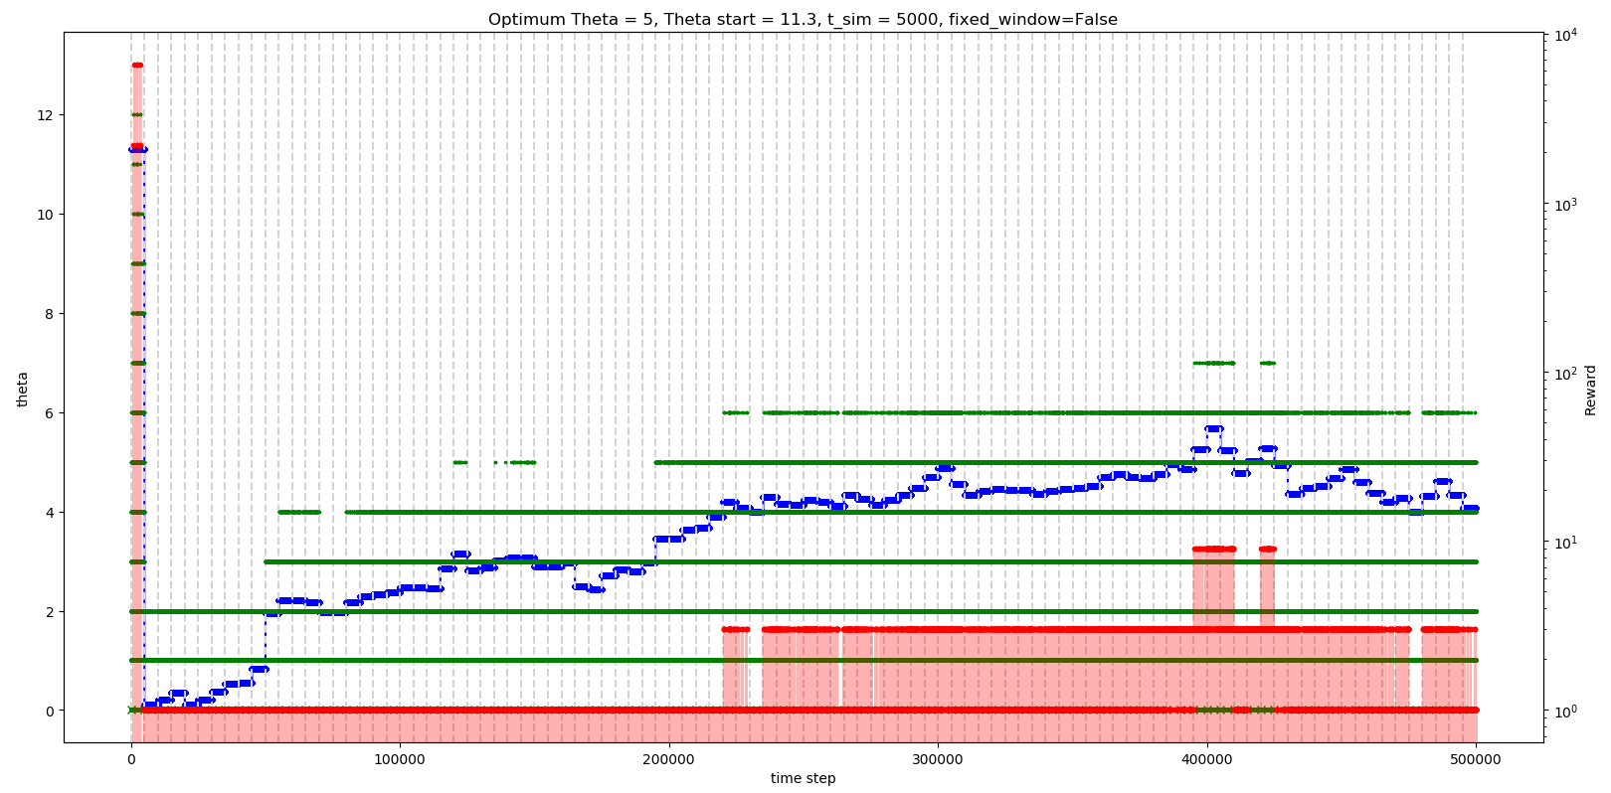
Method 1: T = 5,000, start at θ = 11.3 (large) (α = 1, no constraint on delta(θ))

Slide 19
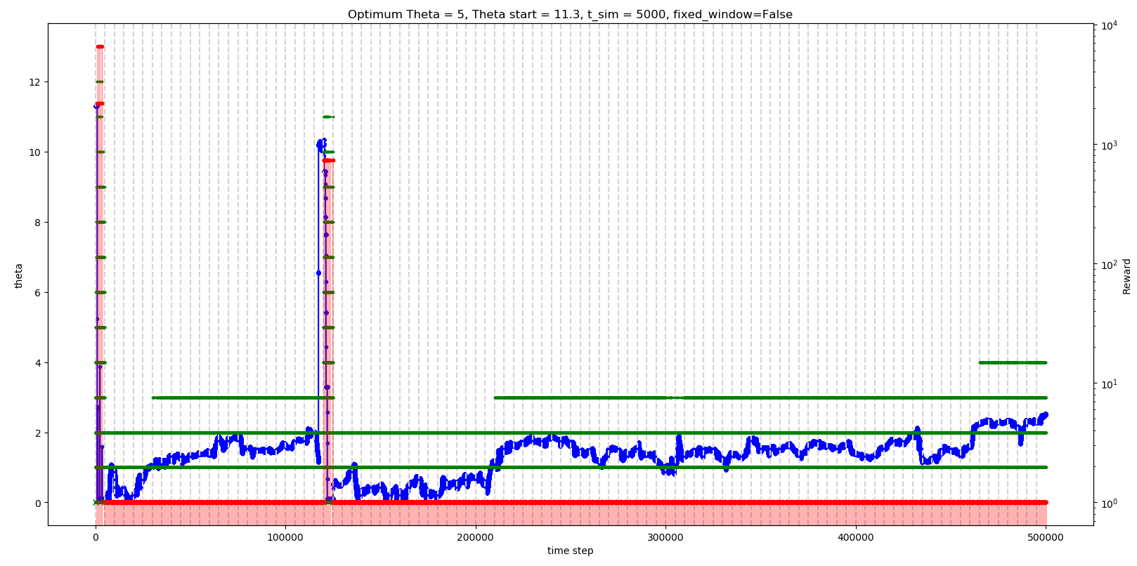
Method 2: T = 5,000, start at θ = 11.3 (large) (α = 1/T, no constraint on delta(θ))

Slide 20
Method 3: T = 10,000, start at θ = 11.3 (large) (α = 1, no constraint on delta(θ))

Slide 21
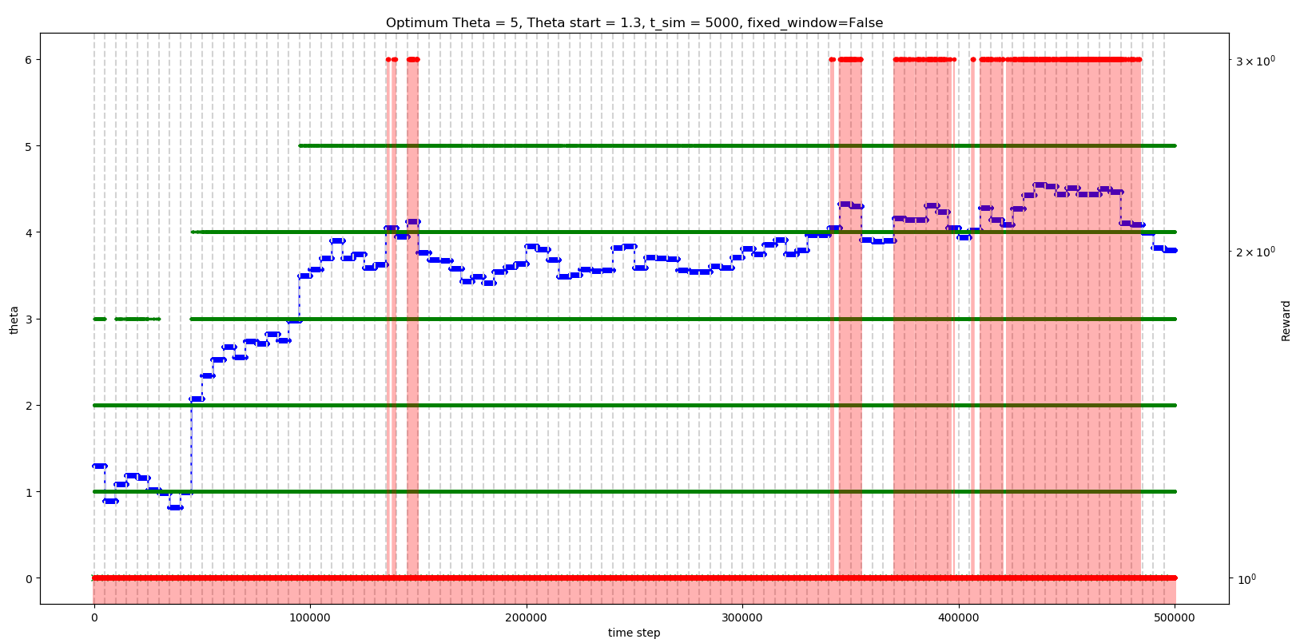
Method 1: T = 5,000, start at θ = 1.3 (small) (α = 1, no constraint on delta(θ))

Slide 22
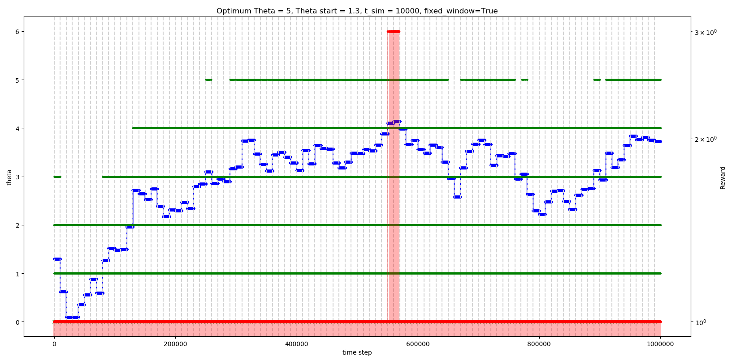
Method 3: T = 10,000, start at θ = 1.3 (small) (α = 1, no constraint on delta(θ))

Slide 23
Thu, 02-Dec-2021 Based on theoretic grad(V)
We estimate directly expression (6) in the Trunk-Reservation paper

Slide 25
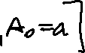
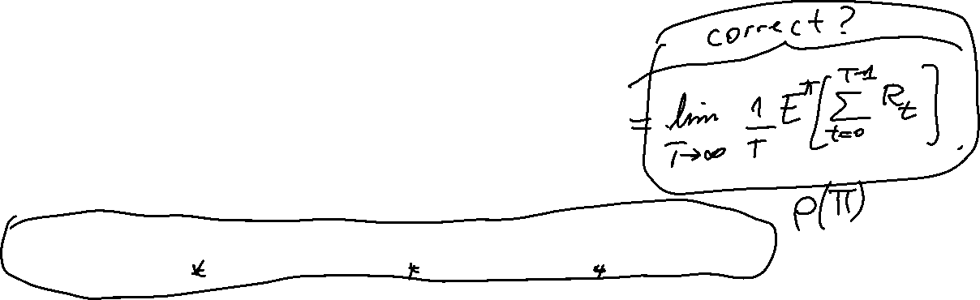
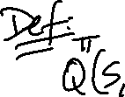

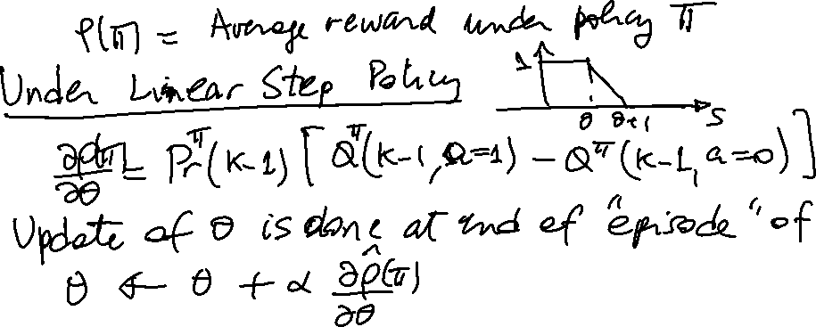


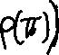
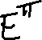
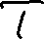


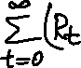

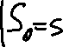
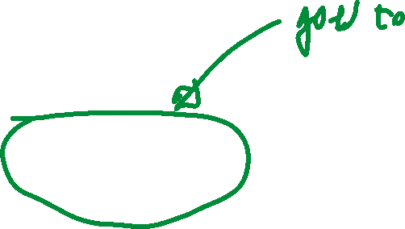
Proposal for the estimation of Q(s,a) under FV

Slide 26
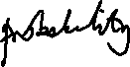

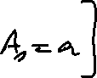
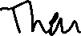
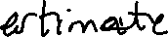
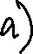
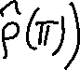
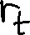
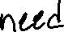
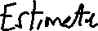
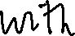
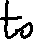
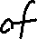
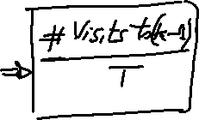
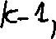
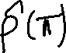

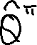















Slide 27









$$E^{π}\left[\sum_{t=0}^{T−1}{r_{t}}−ρ\left(π\right)\right]$$

Slide 28








Slide 29








Slide 30










Estimation of the gradient under FV

Slide 31


Slide 32


Slide 33














Slide 34


Slide 35


Slide 36









Slide 37


Slide 38


Slide 39
Call with Szymon – Thu, 06-Jan-2022 We talked about FV vs. MC MSE

Slide 40

Discussion with Matt on Wed, 05-Jan-2022

Slide 41



Slide 42


Slide 43












Slide 44






























Slide 45


Slide 46


Slide 47








Slide 48
Results for RL control using estimation of the true gradient
14-Jan-2022

Slide 49


13-Jan-2022: α constant until t_learn/3 then decrease at 1/n

Slide 50


14-Jan-2022: α decreases as 1/n

Slide 51


17-Jan-2022: α decreases as 1/sqrt(n) K inicial, J/K, N=#particles, T=Simulation steps
True Theta = 9.0 K start = 20, J/K = 0.2
True Theta = 9.0 K start = 20, J/K = 0.3

Slide 52



17-Jan-2022: α decreases as 1/sqrt(n)
True Theta = 9.0 K start = 20, J/K = 0.3, J inicial = 7

Slide 53
Check new implementation FV vs. original implementation with EstimatorQueueBlockingFV in estimators.py Sat, 22-Jan-2022
Conclusion: the difference where we see that the new implementation underestimates Pr(K) for K small (K = 5) is just due to chance! (as we see a good enough estimation for another seed –1313 instead of 1717.
Ref: test_QB.py -> main section, the test on the “N” mode (as opposed to “J”) mode where I call:
results, results_agg, est_fv, est_mc = Test_QB_Particles.test_fv_implementation(estimation_process=Process.Simulators, …

Slide 54

Using Estimators on K = 5, N = [24, 66, 179] T = [170, 463, 1259] (these parameter values come from the FVRL learning settings)

Slide 55


Using Simulators on K = 5, N = [24, 66, 179] T = [170, 463, 1259]

Slide 56

Using Estimators on K = 5, N = [10, 20, 40] T = 170

Slide 57

Using Simulators on K = 5, N = [10, 20, 40] T = 170

Slide 58

Using Simulators on N = [10, 20, 40], T = 170 (seed=1717) (after fixing count of events in estimation of E(T)
PROBABILITY IS UNDERESTIMATED HERE JUST BY CHANCE!!!
See other slides where we don’t see this underestimation!!

Slide 59

Using Simulators on N = [10, 20, 40], T = 170 (seed=1313) (after fixing count of events in estimation of E(T)

Slide 60

Using Simulators on N = [10, 20, 40], T = 50 (seed=1717) (after fixing count of events in estimation of E(T)

Slide 61

Using Simulators on N = [10, 20, 40], T = 500 (seed=1717) (after fixing count of events in estimation of E(T)

Slide 62
Using Estimators on N = [24, 66, 179] T = [170, 463, 1259]

Slide 63

Simulators: After fixing simulation time measured by the arrival events only N = [24, 66, 179], T = [170, 463, 1259]

Slide 64

Estimators: on 15 replications N = [24, 66, 179], T = [170, 463, 1259]

Slide 65

Simulators: on 15 replications (instead of 8) N = [24, 66, 179], T = [170, 463, 1259]

Slide 66

Estimators: on 10 replications (seed=1717) N = [24, 66, 179], T = 50

Slide 67

Simulators: on 10 replications (seed 1717) N = [24, 66, 179], T = 50

Slide 68
Strategy for creating performance graphs
True K | K start | Delta(Theta) | J/K | Choice of N & T (based on maximum expected ERROR in numerator and denominator)
20 | 30 | No restriction | 0.3 | 150%
 |  |  |  | 100%
 |  |  |  | 50%
 |  |  | 0.5 | 150%
 |  |  |  | 100%
 |  |  |  | 50%
 |  | Clipping | 0.3 | 150%
 |  |  |  | 100%
 |  |  |  | 50%
 |  |  | 0.5 | 150%
 |  |  |  | 100%
 |  |  |  | 50%

Slide 69

17-Jan-2022: α decreases as 1/sqrt(n)
True Theta = 9.0 K start = 20, J/K = 0.2

Slide 70

28-Jun-2022: MC estimation of optimum θ in the policy gradient approach for the single-server queue blocking example, by starting at K-2 instead of at J-1 ~= 0.5K
Ref: simulators.py → execution of FVRL which will be soon moved to test/test_FVRL.py
Results/RL/single-server/SimulatorQueue_20220129_095752_FV-K0=30-K=10-J=0.5-E0.5-Clipping.csv (used as FV benchmark)
However, if we DO NOT use CLIPPING, the MC estimation oscillates a lot and finally explodes because P(K-1) is mostly overestimated as the process has not reached stationarity at start-off, and we are too close to K-1 if we start at K-2. Clipping avoids this explosión.

